Slide 1
Metabolomics Data generation

Slide 2
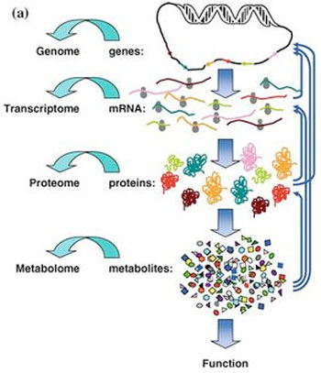
Plants contain ~200.000 bioactive compounds
http://cisncancer.org/research/what_we_know/omics/metabolomics.html

Slide 3
What is the difficulty with measuring metabolites ?
Chemical complexity
Dynamic range
Dynamic flux
Non-linear with annotated gene and protein databases
Notes:
What now is the difficulty with measuring metabolites? What is the difference between profiling all transcripts, all proteins, and all metabolites? Think of the extraction procedure.

Slide 4
Chemical complexity
Non-polar
Polar
fats
waxes
phenolics
alcohols
nucleosides
sugars
terpenoids, carotenoids, steroids
alkaloids
amino acids
metals
Notes:
RNA molecules are made out of 4 different building blocks and therefore will be structurally and chemically quite similar, therefore you can use 1 extraction method to isolate all RNA molecules. Proteins are made with 20 different building blocks + all their post-translational modification, which means that they are structurally and chemically much more different. With proteins you already have to use different isolation techniques in order to isolate for example membrane proteins, cytoplasmic proteins or very basic or acidic proteins. So if you want to measure all proteins, you have to combine different isolation methods and different separation and measuring techniques.
The building blocks of metabolites are highly variable. Metabolites can consist of or contain lipids, sugars, they can be water soluble or lipophilc. Because metabolites are chemically so diverse, you can choose from a large range of isolation methods and different separation and measuring techniques. As a result you will only get a selection of metabolites. Thus like proteomics, metabolomics only exists on paper. Each metabolic profiling experiment only gives you a selection of metabolites.

Slide 5
Chemical complexity
Large diversity in metabolites
probably ~200.000 metabolites in plant kingdom
probably ~20.000 metabolites per plant
Different metabolites, different characteristics
Volatile
Non-volatile: polar, semi-polar and apolar
Different analytical methods are needed!

Slide 6
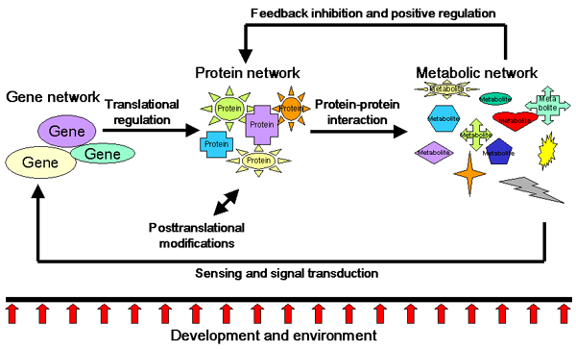
Dynamical range + Dynamical flux
I.Paffen
Notes:
This is a scheme that shows that the metabolic network is a result of the gene expression network and the protein network. However, the protein network and the gene expression network can be affected by the presence of certain metabolites via feedback mechanisms. Thus there can be feedback of metabolites on the functionality and expression of proteins, but also on the expression of genes.

Slide 7
What is the difficulty with measuring metabolites ?
Chemical complexity
Dynamic range
Dynamic flux
Non-linear with annotated gene and protein databases
Notes:
What now is the difficulty with measuring metabolites? What is the difference between profiling all transcripts, all proteins, and all metabolites? Think of the extraction procedure.

Slide 8
Data generation
Metabolomics
Profiling all metabolites + identification
Metabolite target analysis
Just a few known specific compounds
Metabolite profiling
Profiling classes of metabolites + identification
Metabolite fingerprinting
Profiling classes of metabolites + no identification
Notes:
There are three ways that you can look at metabolites.
Metabolomics tries to make a profile of all metabolites in a certain celltype at a certain timepoint. This is only possible by combining different profiling experiments. Because for each profiling you make a selection of metabolites based on the isolation method and measuring technique.
Metabolomite profiling: measure metabolites in a certain extract, but also try to identify the components that you measured, so identify the chemical structure of each peak. If you know the chemical structure of the compound you can try to relate the compound to a unknown gene or you can relate it to a certain biochemical pathway. But identification of metabolites is very difficult, because there are so many different metabolites present in a cell. Therefore many metabolites are not identified yet.
For many applications it is not really necessary to identify the measured metabolites. For these applications you can obtain enough information by just comparing the peaks in the profiles. This is called metabolite fingerprinting. With metabolite fingerprinting you can compare for example urine samples from different patients and based on peaks you can decide the disease status of that patient. Because the profile of healthy people will differ from the profile of diseased people.

Slide 9
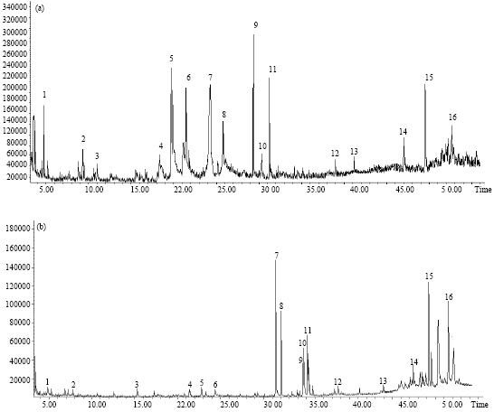
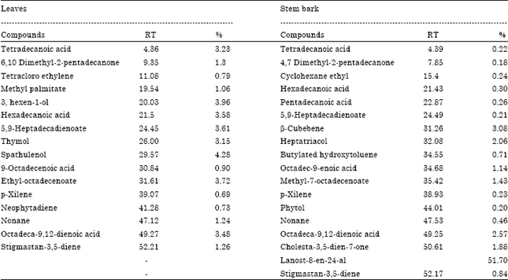
GC-MS Analysis of Scutia buxifolia Reissek Leaves and Stem Bark
Bolignon et al. 2014, Research Journal of Phytochemistry, 8: 16-20.
Notes:
Rhamnaceae family comprising about 58 genera and approximately 900 species, between the species highlight Scutia buxifolia Reissek (coronilha) that is mostly distributed in the Brazil, Argentina and Uruguay (Wasicky et al., 1964; Menezes et al., 1995). In these regions, an infusion of the steam bark of S. buxifolia has been described and widely used in folk medicine for cardiotonic, diuretic and antihypertensive purposes (Wasicky et al., 1964). Some biological properties have been described in S. buxifolia extracts and fractions, such as, antimicrobial, antimycobacterial, antiviral and cytotoxicity activities (Morel et al., 2005; Boligon et al., 2012b), antioxidant capacity (Boligon et al., 2009; Boligon et al., 2012a) and protective effects against chromosome damage induced by H₂O₂ (Boligon et al., 2012c). In addition, the presence of phenolics acids, flavonoids, steroids, terpenoids, tannin and alkaloids has been described previously in S. buxifolia (Menezes et al., 1995; Boligon et al., 2009, 2012a). However, no study by GC-MS identified the constituents present in the nonpolar fractions of the species.
The aim of the present study was to investigate the phytoconstituents present in dichloromethane fraction of S. buxifolia stem bark and leaves by gas chromatography-mass spectrometry (GC-MS). The results presented here are first reported for the species.

Slide 10
Metabolomics Flowscheme
Biological question
Sampling
Measurement
Processing output
Data comparison and visualisation
Data verification
Data interpretation
Size of sample compared to whole organism
Multiple samples
Pooled samples
Sample storage
Sample extraction
Notes:
With al these biological variation you thus really have to think about how you will take your samples. First, of course which extraction method to use, then at what time points, but also which size. You can take a sample of the whole organism or take multiple smaller samples. These smaller samples can be pooled. But if you pool samples you will average a lot of biological variation. This might be useful, but there can also be information stored in this biological variation that you remove by pooling. Another thing you have to think about how you are going to store your samples, because that can also have an effect on metabolite levels.
Metabolomics is difficult !!

Slide 11
Biological and technical variation
Technical variation sources
Extraction
Derivatisation reaction
GC run (retention time)
Fragmentation
Deconvolution peaks
Ion suppression
Biological variation sources
Micro environment
Stochastic processes
Intrinsic regulation
Notes:
Why is normalisation and alignment necessary?
Due to high amount of variation. Technical variation: extraction procedure itself. It is so sensitivity that it is sometimes possible to see who did the extraction. The derivatisation reaction does not always work with the same efficiency. There are always slide changes in retention times during the GC run. Even though you always use 70 eV for fragmentation, fragmentation can sometimes be more efficient than at other times. Then the way the fragments in you sample are assigned to the peaks in the spectrum can also vary. This has to do with how fast the MS apparatus can measure. The MS scans through the whole range of masses. If the MS apparatus is fast enough, it will do several complete scans during the time a molecule elutes from the GC-column. In the MS spectra, you will then see the fragment peaks go up and down together. If the MS apparatus is slow, it is possible that it measures the low masses at the beginning of the intensity peak and the high masses at the middle of the intensity peak. The software will now not be able to group the peaks that were derived from fragmenting the molecule, because the do not go up and down at the same time. It will probably result in a false identification.
An other problem that may occur is that when a lot of molecules coming of the GC column at the same time. From these molecules a lot of ions are being formed during the ionisation process. During the fragmentation process the fragments compete with each other for ion formation, and thus inhibit each others ionsation process resulting in a lower signal. This is called ion suppression.

Slide 12
Biological and technical variation
Technical variation sources
Extraction
Derivatisation reaction
GC run (retention time)
Fragmentation
Deconvolution peaks
Ion suppression
Biological variation sources
Micro environment
Stochastic processes
Intrinsic regulation
Notes:
These are all sources of technical variation. Compared to the biological variation, the technical variation is small. Most of the variation has a biological origin.
What are the sources of biological variation? It can be the micro environment. For example two “identical” plants grown in the greenhouse can already show biological differences, because they did not grow on exactly the same spot. The second source of biological variation comes from stochastic processes. Some processes are regulated by a certain molecule that is present at a very low concentration in the cell. For example transcription factors. When you take a sample exactly at the time when this molecule has its effect, you will measure different metabolite levels than at a timepoint where this molecule did not have an effect.
Another source of biological variation is intrinsic regulation.

Slide 13
Metabolomics Flowscheme
Biological question
Sampling
Measurement
Processing output
Data comparison and visualisation
Data verification
Data interpretation
Notes:
Flowscheme:
· You always start out with the biological question
· How do you sample, how much do you sample
· Different techniques to measure the presence of metabolites in your sample. Today we will mainly focus on GC-MS for measuring metabolites
· Processing of the output of these measurements (Doing a measurement is not so difficult and analysis of a single measurement is also not difficult, but if you do a lot of measurements, measuring thousands of metabolites and you want to compare these measurements, the analysis of the data becomes quite difficult.
· Data comparison and visualization of the data, for example with PCA plots.
· After analyzing the data and identifying some compounds that are of interest, you have to go back to your original data to verify that the software did not make any mistakes in all the processing and analysis steps.
· After that you can try to interpret the metabolite data and couple it to metabolic pathways, or integrate it with transcriptomics or proteomics data.
So this is a very general scheme about what is involved with doing a metabolomics experiment.

Slide 14
Analytical techniques
Gas Chromatography Mass Spectrometry (GC-MS)
Liquid Chromatography Mass Spectrometry (LC-MS)
Nuclear Magnetic Resonance (NMR)
Fourier-Transform Infrared Spectroscopy (FTIR-MS)
Notes:
Different analytical techniques used to measure metabolites.
Techniques that are used most are GC-MS and LC-MS. NMR is also used often, but it has low sensitivity. Therefore it needs high amounts of sample for its measurement. But when it can measure a compound the resolution is very high, so that it can be used for compound identification.
FTIR-MS is not used very often. It has very high resolution, and not much compound is needed, but it is very expensive.
GC-MS, LC-MS, and also NMR are not newly developed techniques. They already exist for quite some time. However, 20 years ago people looked specifically at a certain compound or a small group of compounds. Nowadays we want to look at all metabolites at the same time, making things much more complicated. But these days this is possible due to better instruments and the availability of computers and good software.

Slide 15
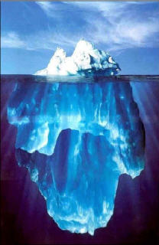
Sensitivity of analytical techniques
NMR
GC/MS
LC/MS
FTIR-MS
10⁻⁶ mol
10⁻¹² mol
10⁻¹⁵ mol
10⁻¹⁸ mol
https://mghspeakfreely.wordpress.com/

Slide 16
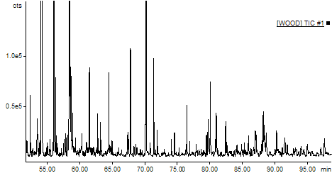
LC-MS / GC-MS
Chromatogram
Sample
Chromatography
column
detector
Retention time
1
2
3
4
5
6
MS
Retention time
http://massfinder.com/wiki/MassFinder_Tools_dialog
Notes:
Explain principle of GC-MS in order to be able to analyse GC-MS metabolomics data. For this it is necessary that you learn something about how the data was generated.
LC-MS and GC-MS measure metabolites in two steps. In the first step you separate the complex mixture of metabolites in your sample. With Gas Chromatography you separate metabolites in the gas phase, so volatile components. With Liquid chromatography you separate the metabolites in a solvent. During the chromatography step you will separate the metabolites in your complex mixture, As a result you get a chromatogram with retention times that correspond to the time a metabolite came of the column. In the second step you measure by mass spectrometry for each retention time, the m/z values of the components that came of the column.

Slide 17
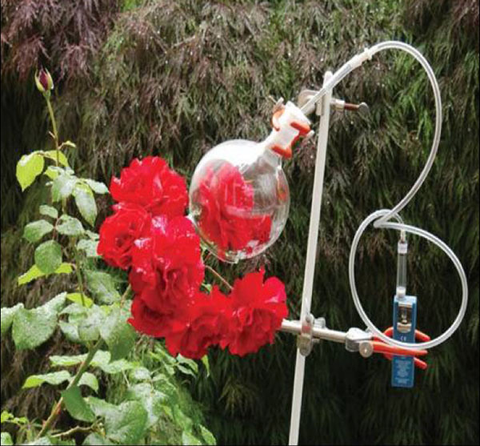
GC-MS
https://urbanheritages.wordpress.com/category/istanbul/
Isolate metabolites
Headspace trapping or
Metabolite Extract
+ derivatisation of non-volatile components
Separation by GC
Ionisation of volatile compound (fragmentation)
Mass Detection ions
Notes:
With GC-MS you measure compounds that are in gas phase. You can measure compounds that are already volatile. For example when you are doing research on the fragrance of flowers, you can just collect the compounds that the flower releases and measure them.
However, you can also measure compounds that normally are not volatile, but then you have to make them volatile by a chemical procedure called derivatisation. During this procedure you treat your sample with a certain chemical that will add groups to your metabolite so that it will more easily enter the gas phase. After derivatisation, the sample is loaded on the GC column where the sample is heated. Very volatile components will enter the gas phase first and less volatile compounds will get volatile later. So you obtain a gradient of compounds that will flow through you the column.
By doing GC you already make a selection on the type of compounds you are analysing. If you only measure the metabolites that are present in flower fragrance you can find roughly 200 compounds. If you extract metabolites from a tissue and derivatise them you can find 10000-20000 compounds.

Slide 18
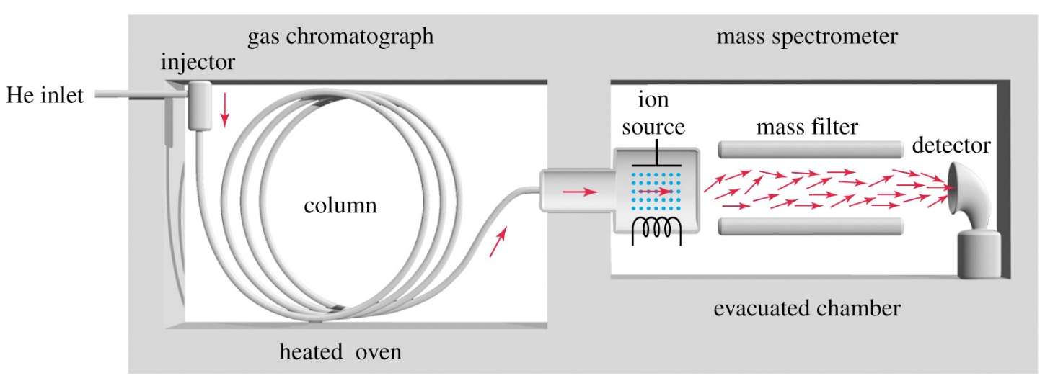
GC-MS
Separation by GC
Ionisation of volatile compound (fragmentation)
Mass Detection ions
abundance
m/z
Electron Impact Ionisation 70 eV
http://orgspectroscopyint.blogspot.nl/2014/11/gas-chromatography-mass-spectrometry-gc.html
Notes:
After GC you have to send the compounds to the mass spectrometer and measure the m/z value. If you want to measure something with MS, your molecules should be ions. In the GC phase, the molecules are not charged. So the molecules have to go through a process of ionisation. For GC-MS analysis, molecules are usually ionised by Electron Impact Ionisation.
Electron Impact ionisation is a hard ionisation method. This is in contrast to Electrospray Ionisation or MALDI, which are soft ionisation methods that are usually used for analysing peptides and proteins, With Electron Impact ionisation you bombard you molecules with an electron beam to give these molecules a charge. However, this bombardment is so strong that very often it will break the molecules into pieces. As a result you will get multiple fragment ions from a single metabolic compound. These fragment ions can have a positive or a negative charge. By doing MS in either the positive or the negative mode, you can measure the m/z values of these ions. In the resulting MS spectrum of this compound you will see a small peak for the complete metabolic compound and multiple peaks for the fragment ions coming from this compound. By combining the molecular masses of these multiple peaks you can identify the molecule.

Slide 19
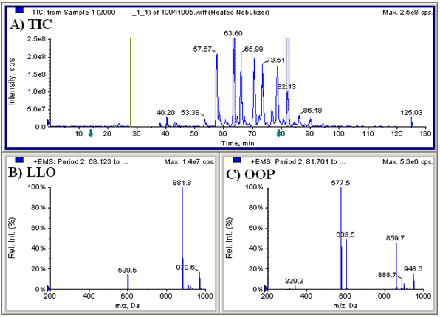
GC-MS – data analysis
TIC chromatogram
Peak hight corresponds to combination of peaks in MS spectrum
One peak can consist of multiple metabolites
MS spectrum
Molecular fragment ions
Isotopes
http://lipidlibrary.aocs.org/Analysis/content.cfm?ItemNumber=39287
Notes:
By doing GC-MS analysis you will first obtain a chromatogram where peaks represent the amount of molecules coming from the column at a certain retention time. In the chromatogram you can have on the x-axis either a time scale or the MS scan number. At regular retention time points an MS spectrum of compounds in the eluate is made.
Thus, after doing GC-MS analysis you will have one chromatogram and multiple MS spectra.
The chromatogram is often called the TIC chromatogram. TIC = Total Ion count. TIC is correlated to the peaks in the MS spectrum. If you combine the intensities of all ion masses in the MS spectrum you will obtain a value that corresponds to the peak height in the chromatogram.
When at a certain retention time only one metabolite elutes from the GC column, then all peaks in the MS spectrum are derived from this metabolite. However, usually more than one metabolite elutes from the column. These metabolites are all ionised and analysed by MS at the same time, resulting in an MS spectrum containing multiple fragmentation patterns. Then it is much more difficult to do the analysis, because by looking at this spectrum you don’t know which peaks belong to which molecule. Luckily there is good software that can do the job for you.
Thus the peaks in the MS spectrum are the result of fragmentation of the metabolite upon ionisation. In addition, each fragment has a certain isotope distribution, which may result in additional peaks.

Slide 20
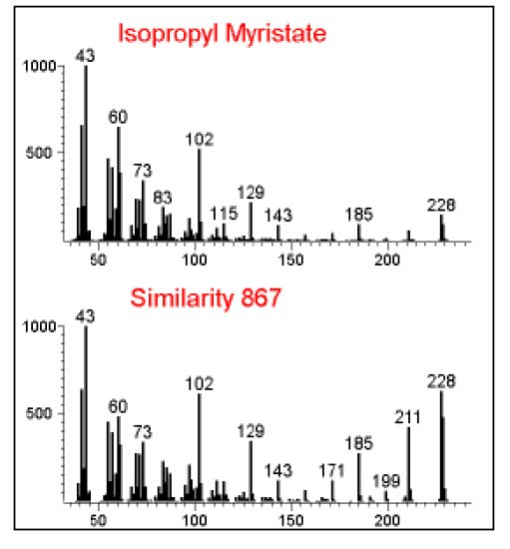
GC-MS – compound identification
MS spectrum in database
Compound identification based on:
Retention time
Fragmentation pattern
Isotope distribution at each specific mass
Differences between main masses can identify sub-groups
No distinction between isomers
Acquired MS spectrum
http://webbook.nist.gov/cgi/cbook.cgi?ID=C110270&Mask=200#Mass-Spec
Notes:
During the ionisation process, molecules are broken into pieces. Therefore, the MS spectrum contains the fragmentation patterns of these molecules. Each molecule gives a specific fragmentation pattern. Therefore you can use this fragmentation pattern to identify the molecule. Like MS/MS with proteins you can find the corresponding metabolite by comparing the fragmentation pattern with a library of fragmentation patterns.
By doing GC-MS you can identify your metabolite by combining the retention time with the fragmentation pattern measured by MS. The fragmentation pattern is specific for the molecule only because there is an agreement on how to perform the measurements. Each GC-MS measurement is performed using the same amount of energy for Electron Impact ionisation of the molecules, which is 70 eV. When somebody uses more energy, the Electron beam will result in another breakdown pattern of the molecule.
Besides the fragmentation pattern also the isotope distribution can give you some information about the identity of the molecule. Remember that each atom has a certain isotope distribution. When molecules get larger, the change of containing one or more isotopes increases. Isotopes differ from each other with ~1 Da. When the charge (z) of the ion is 1, the peaks in the MS spectrum are ~1 Da apart. When the resolution of the MS apparatus is high enough the presence of isotopes in the eluate can be nicely measured.
Of course, when the charge of the ion is not 1, the difference between the peaks in the MS spectrum is less than 1.

Slide 21
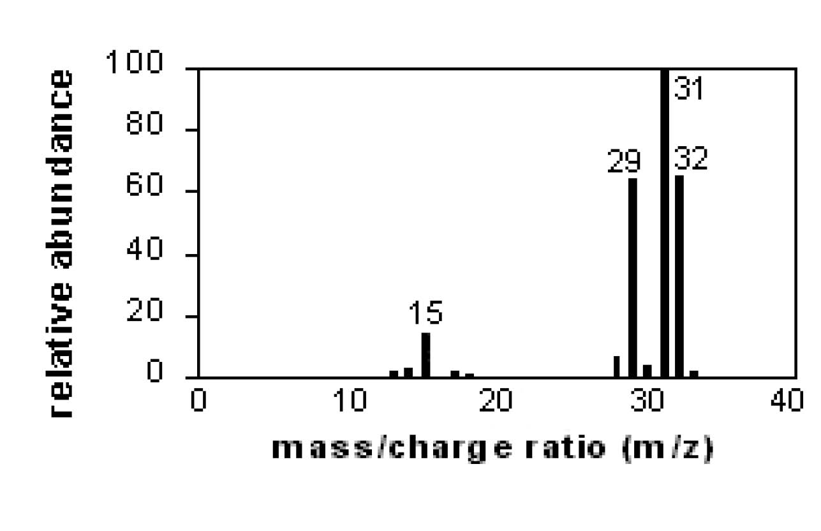
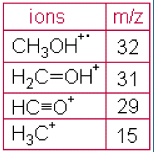
Mass Spectrum of Methanol
http://webbook.nist.gov/cgi/cbook.cgi?ID=C67561&Mask=200#Mass-Spec

Slide 22
Metabolomics Flowscheme
Biological question
Sampling
Measurement Accuracy !!!!
Processing output
Data comparison and visualisation
Data verification
Data interpretation
Notes:
Flowscheme:
· You always start out with the biological question
· How do you sample, how much do you sample
· Different techniques to measure the presence of metabolites in your sample. Today we will mainly focus on GC-MS for measuring metabolites
· Processing of the output of these measurements (Doing a measurement is not so difficult and analysis of a single measurement is also not difficult, but if you do a lot of measurements, measuring thousands of metabolites and you want to compare these measurements, the analysis of the data becomes quite difficult.
· Data comparison and visualization of the data, for example with PCA plots.
· After analyzing the data and identifying some compounds that are of interest, you have to go back to your original data to verify that the software did not make any mistakes in all the processing and analysis steps.
· After that you can try to interpret the metabolite data and couple it to metabolic pathways, or integrate it with transcriptomics or proteomics data.

Slide 23
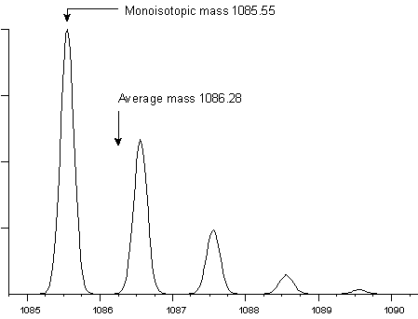
Mass accuracy
Average mass 1086.3 Da
Monoisotopic mass 1085.55 Da
http://www.matrixscience.com/help/mass_accuracy_help.html
Notes:
Mass Accuracy
If you ask the question “what is the molecular weight of a certain molecule” the honest answer should be that you do not know. Due to isotope distributions, there is always a population of molecules that looks like this molecule. When you know the isotope distribution you can calculate the average weight of the molecule. The monoisotopic mass is the molecule that contains only the most abundant isotopes, so carbon 12 and nitrogen 14. When the metabolite is not so large, the monoisotopic mass will give the highest peak in the MS spectrum. Besides the average mass and the monoisotopic mass, there is also the nominal mass. This is just the standard molecular weight of the atom with rounded number, so 12 for Carbon, 14 for Nitrogen and 16 for Oxygen.
It is thus possible that multiple peaks in the MS spectrum all represent a certain molecule. Each peak in the MS spectrum represents one type of molecule with a certain isotope composition and thus a different accurate mass. The nominal mass is the first peak, that is usually the highest one. The average mass is the average of the correct mass of all these peaks. The nominal mass is the same for all peaks, because it is based on the standard rounded numbers taken from the system of elements.

Slide 24
Mass resolution
Resolution = M / ΔM = 1085.55/0.22 ≈ 5000
0.22
1Da
http://www.matrixscience.com/help/mass_accuracy_help.html
Notes:
In order to identify the peaks representing different isotopic compositions, the resolution of the MS apparatus has to be high enough.
Mass resolution is the dimensionless ratio of the mass divided by the mass difference at a 50% valley. Or when there is no valley, the peak width at 50% of the peak hight. In this case the resolution was 1085/0.22 = ~5000.
If you do not know the charge of the ion, you can look at the difference between the isotope peaks. When the charge is one, the difference between those peaks is also one, but when the charge is 2 the difference between the peaks is ½=0.5.

Slide 25
Metabolomics Flowscheme
Biological question
Sampling
Measurement
Processing output
Data comparison and visualisation
Data verification
Data interpretation
Notes:
Flowscheme:
· You always start out with the biological question
· How do you sample, how much do you sample
· Different techniques to measure the presence of metabolites in your sample. Today we will mainly focus on GC-MS for measuring metabolites
· Processing of the output of these measurements (Doing a measurement is not so difficult and analysis of a single measurement is also not difficult, but if you do a lot of measurements, measuring thousands of metabolites and you want to compare these measurements, the analysis of the data becomes quite difficult.
· Data comparison and visualization of the data, for example with PCA plots.
· After analyzing the data and identifying some compounds that are of interest, you have to go back to your original data to verify that the software did not make any mistakes in all the processing and analysis steps.
· After that you can try to interpret the metabolite data and couple it to metabolic pathways, or integrate it with transcriptomics or proteomics data.
So this is a very general scheme about what is involved with doing a metabolomics experiment.

Slide 26
Data analysis
Sample 1
Sample 2
Baseline correction / normalisation
Sample alignment
Deconvolution
Fill in table
Notes:
After generating data from GC-MS it is possible to store your data in a big table. In this table you can put in the first column the scan number or the retention time. In the second column the different mass/charge values that you measure and in the third column the intensity value of the peak. This will result in a very large table with thousands of datapoints, because for each scan number you will get al long list of masses derived from fragmentation of the metabolites that eluted at that particular retention time, but there are also peaks derived from the different isotopic compositions of those fragments.
When you do a measurement for another sample and also put that data in a table. It is possible to compare these two tables and look at the differences. However, there is a lot of variation between two measurements, so the output is never going to be the same. This makes comparison quite difficult, especially when the tables contain 20.000 datapoints. Fortunately there is dedicated software that can compare datasets. Before you can compare the datasets you first have to normalise and align the two chromatograms. Just like you do with microarrays, removing the technical variation. As a result you can now compare mass peaks derived from the same molecule and not different mass peaks.

Slide 27
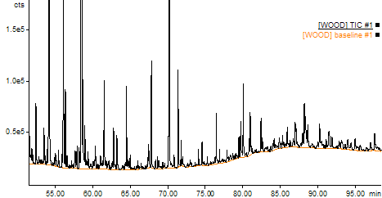
Processing output – Baseline correction
http://massfinder.com/wiki/MassFinder_Tools_dialog
Notes:
f you do a run, you will see that the baseline of your chromatogram is not always at the same position. The baseline represents the background signal present in your measurement. The amount of background can vary between samples, but also between different retention times.
Thus before analysing the data, it is necessary to remove the background by doing baseline correction. After baseline correction, it is of course much easier to identify the metabolites that were measured or to compare two samples.

Slide 28
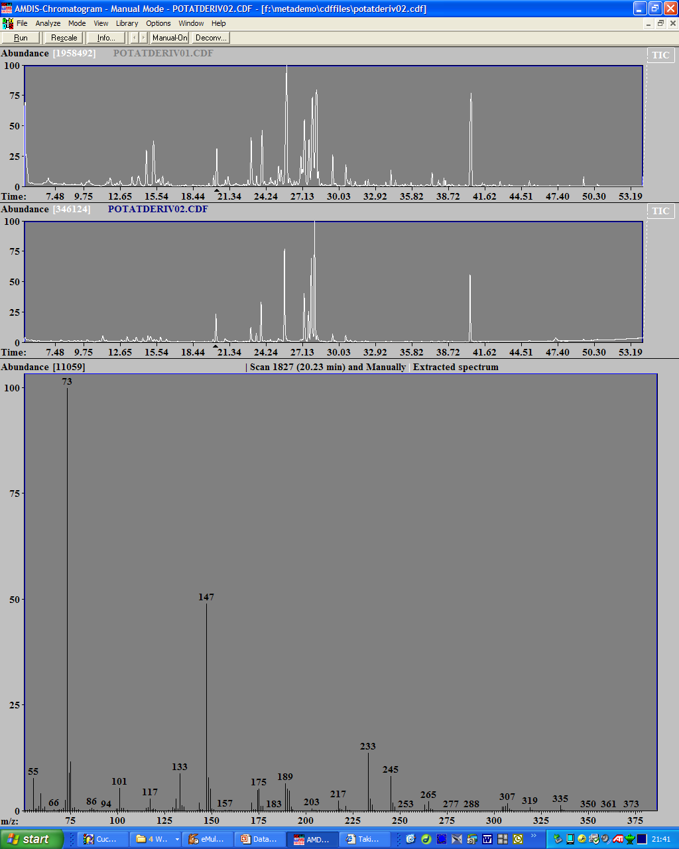
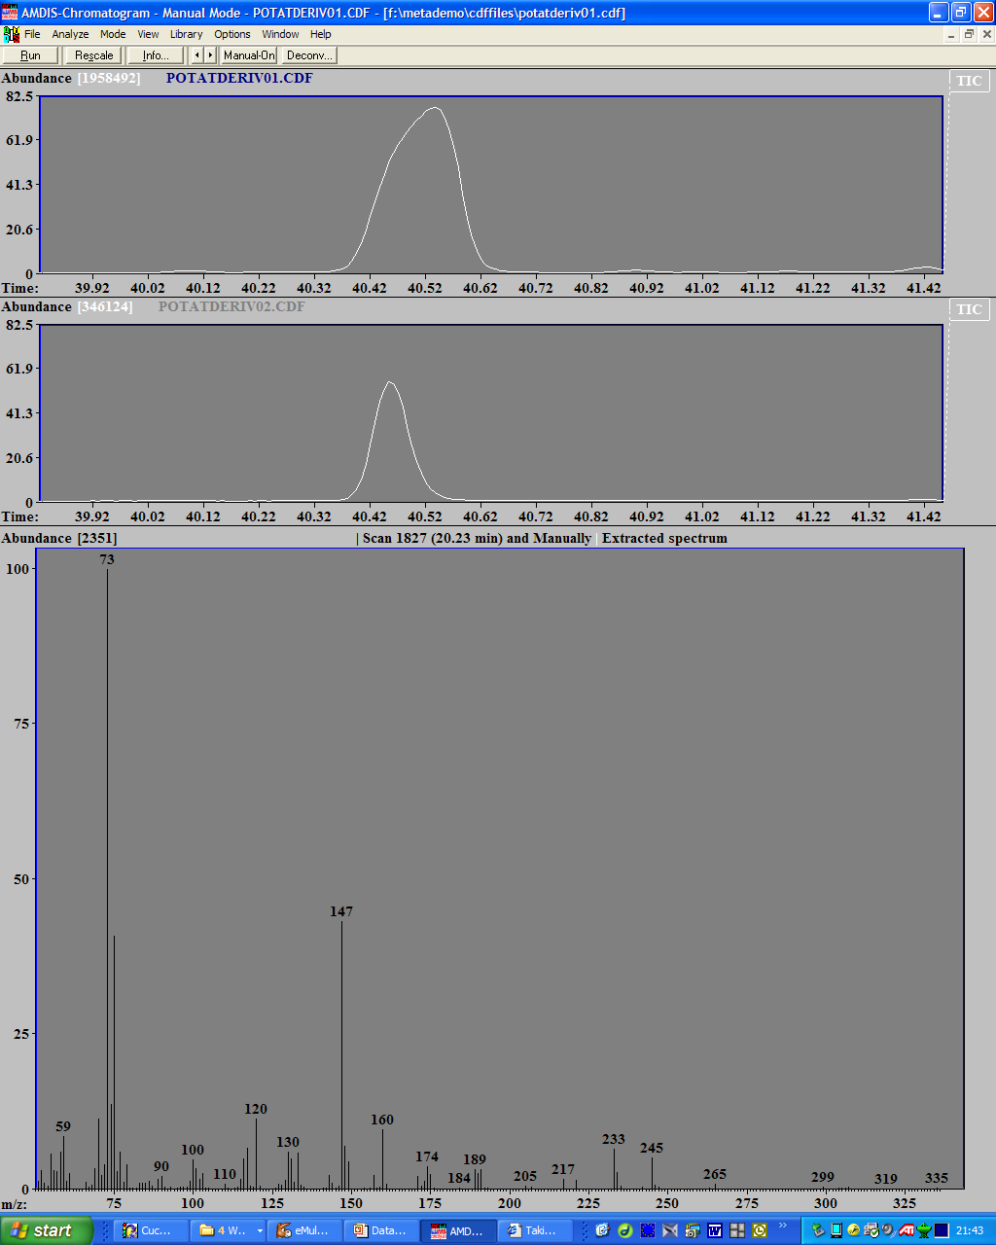
Processing output – Sample Alignment
Figuur gemaakt met Amdis software
Notes:
In software packages were you can compare measurements, the first thing that is done is a baseline correction. Then align the samples, so that the same peaks have the same retention time.
Here are the GC-MS results of two different samples. From the chromatogram you can see that the sample are quite alike, but there are some differences. When you zoom in on the boxed peak you find that although both peaks have a comparable MS spectrum, the retention times are not the same. There is a shift in the retention times of the chromatogram.
In order to compare the chromatograms of these two samples it is obvious that you have to align the chromatograms. So if you look at this peak it is necessary to shift the upper chromatogram a little bit to the left to align the two peaks. Unfortunately, at another retention time, it might be necessary to shift the upper chromatogram a little bit to the right to align two peaks. So the variation that occurs between two samples is not the same for the whole chromatogram, it is non-linear. Therefore, for each retention time there will be a different amount of correction. If you have a chromatogram with only a few peaks it is simple to do this alignment by hand, but with the large datasets produced by profiling experiments with thousands of peaks it is not possible to do it by hand. Luckily, dedicated software has been developed to do the job for you. This software can locally recognise differences and locally adjust the retention times to align the two chromatograms.

Slide 29
Processing output – Sample Alignment
Sample 1 | Sample 2
Figuur gemaakt met Amdis software
Notes:
When the alignment has been performed it is possible to put the data in a table and compare the two samples. In this table you get for each sample a list of fragments. In this example, you have the table of the fragments that were measured at a certain retention time. Each fragment is represented by a different colour green. Each fragment can have different isotopic compositions, therefore sometimes there are more rows with the same colour green. In sample 1 you measure 4 different fragments and in sample 2 you measure 3 different fragments. Because of the difference in metabolite quantity between sample 1 and sample 2, there will be a difference in peak intensity of the fragment ions. As a consequence it is possible that in one of the samples some of the fragments or isotopic compositions of fragments do not reach intensity levels that are above background. In that case you will find one fragment in the first sample, but not in the second sample, or the other way around.
Now the problem is that if you put all the measured masses below each other in a table it is not possible to directly compare the masses that were measured in sample 1 with the masses that were measured in sample 2. You first have to shift the rows of the table to align the fragments.

Slide 30
Processing output – Sample Alignment
Chromatograms need to be alligned before output files can be compared.
RT (scan nr) | mass | Sample 1 | Sample 2
45.34 | 147 | 0.7894 | 0
45.36 | 147 | 0 | 0.8947
Notes:
Besides this problem, there is also another problem. Because there can be different isotopic forms of fragments it is possible that all isotopes of a certain compound do not come of the GC column at the same retention time. When the alignment of two chromatograms is not completely perfect, it is also possible that some fragments or isotope forms are assigned to a different retention time.
Thus in conclusion, it is very difficult to compare data in a table form. In the exercise you will see that once you have the table nicely ordered that it will give the same results as with analysing by PCA. However, manual analysis takes a lot longer, especially if you have very large datasets.

Slide 31
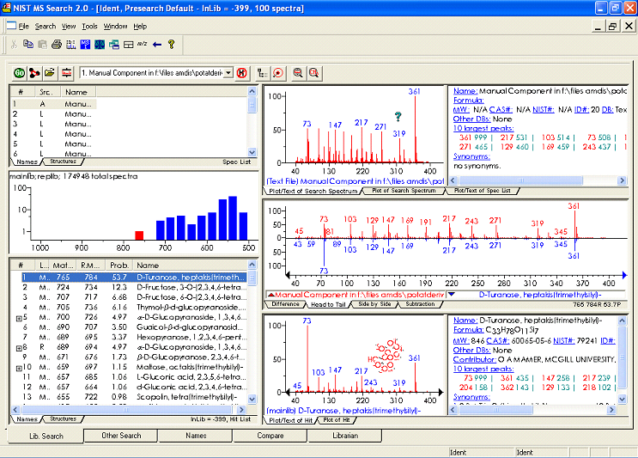
GC-MS – compound identification
AMDIS - http://chemdata.nist.gov/mass-spc/amdis/
Notes:
The AMDIS program is freely available American software, which can be used for GC-MS analysis. Originally, the reference library that came with the program contained compounds that can be used for chemical warfare. Nowadays the program also has a reference library containing more innocent biological molecules.
Here is a comparison of a fragmentation pattern with a library of known compounds. In red you see the measured fragmentation pattern at a certain retention time. This fragmentation pattern is compared in silico with the fragmentation patterns of the compounds in the library. You will then get the probability that tells you how likely it is that the unknown compound is identical to the compound from the library.
It is difficult to get an exact match. Often some fragment peaks are not present in the MS spectrum. This can be due to the fact that these fragments were not ionised easily and thus could not be detected above background levels. Furthermore, because of the complexity of the metabolome, libraries are by far not complete. It is very well possible that the measured compound is not known yet and thus is not present in the library. However, the presence of a compound in the library is not always enough for identification of the compound. For example, you can have stereo-isomers, that of course give the same fragmentation pattern, so you cannot distinguish between the isomeric structures. For this you need other methods for identification, like NMR.
Furthermore, you are dependent on the contents of the library. If the compound is not in the library, you can not find it.

Slide 32
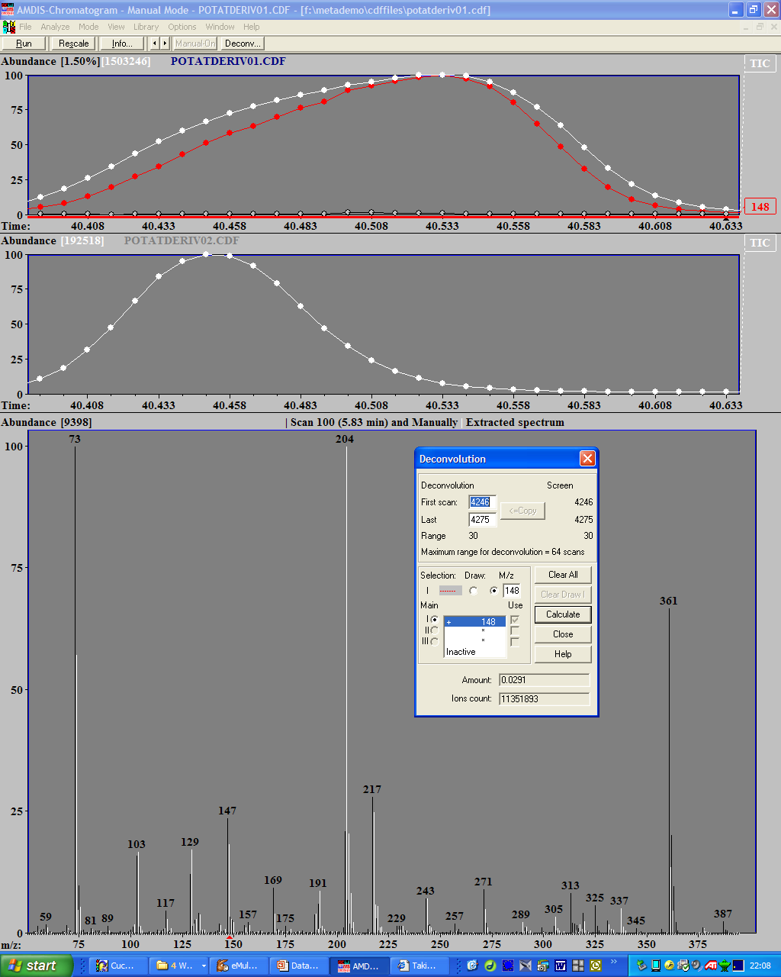
Processing output - Deconvolution
Figuur gemaakt met Amdis software
Deconvolution:
grouping of mass peaks that together are responsible for peak in TIC
White mass peaks:
have maximum at maximum of peak in TIC
Black mass peaks:
have maximum at different retention time
Notes:
For GC-MS, you generate fragments of the metabolites during Electron Impact ionisation. Resulting in a specific fragmentation pattern that can be used to identify the molecule. A metabolite never comes off the GC column at only a single retention time, therefore the fragments generated from this metabolite will be present in multiple scan, and because the belong to the same metabolite they will go up and down in intensity in the same way. The software looks at the intensity of all MS peaks and groups those peaks that are going up and down in the same way. If you click at a certain retention time, the software will give you the mass peaks that have their maximum at the maximum of the peak in the TIC chromatogram.
Question: how can the software find out which fragments belong to the same metabolite.
The MS spectrum contains fragmentation patterns of multiple compounds. How does the software find out which peaks belong to which fragmentation pattern? Usually a compound elutes over a range of retention times. By comparing the peaks in the MS spectra at all these retention times, you can find a set of peaks that go up and down in intensity in the same way. These peaks probably belong to the same metabolite. When two peaks are overlapping, the software can still detect which fragments belong together. Because all these subfragments reach a peak in their intensity value at the same time.
Exercise: Select some peaks in AMDIS. Select some peaks (no more than 64 scans) for manual deconvolution. Press deconvolution button. Then press copy in the window you obtain. This will copy the selected scan region to the deconvolution window. Then you can select a peak and determine which compound has a high probability of being the measured compound.

Slide 33
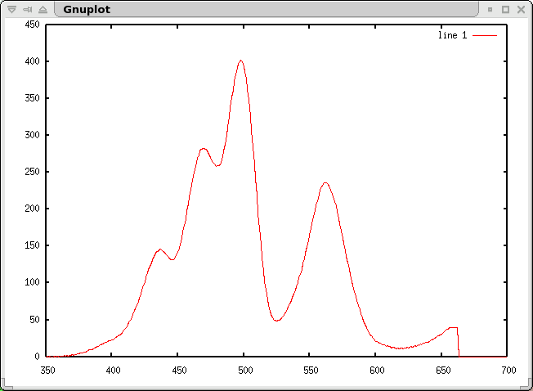
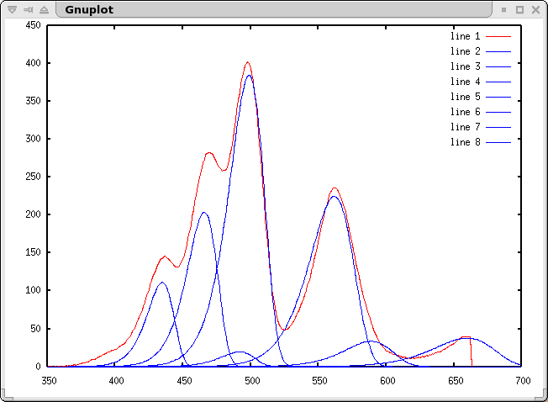
Deconvolution example
https://neptun.phys.au.dk/~bassler/DECONVOLUTION/gc_deconv.html

Slide 34
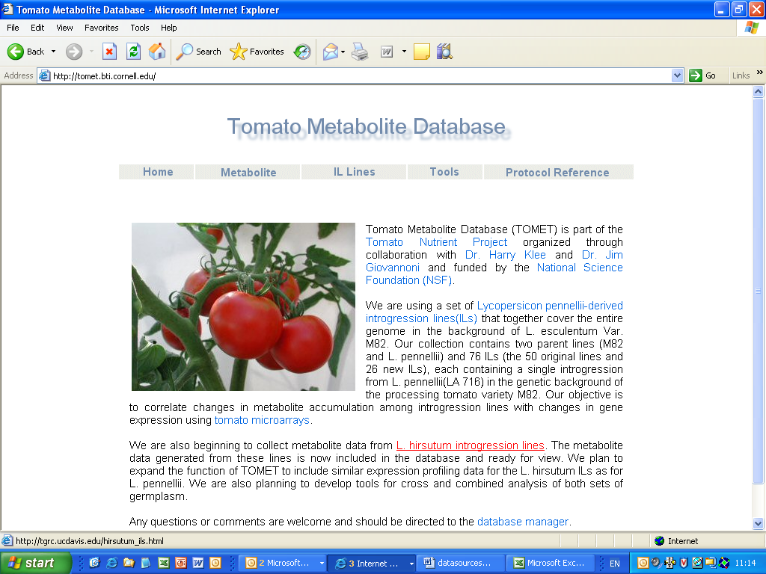
http://tomet.bti.cornell.edu/
Notes:
These are examples of different metabolite databases that can be used as reference library for the identification of components.
The problem of these databases is to unify the measurements that are measured all over the world. There is already an agreement on the amount of energy used for ionisation (70 eV), but you can also vary in the length of the GC column that you use. The longer the column, the better the separation. But if you change the length of the column, also the retention times of the compounds will change. Therefore you cannot use the retention time for identification of the compound.
http://tomet.bti.cornell.edu/

Slide 35
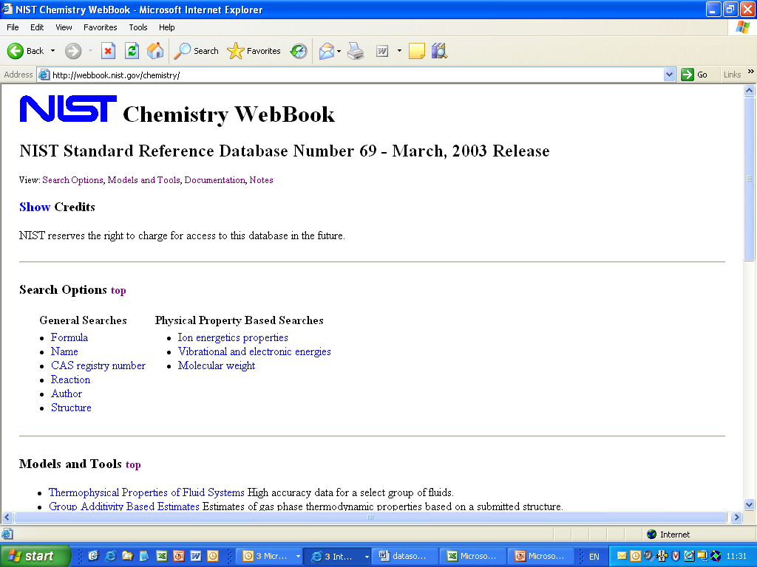
http://webbook.nist.gov/chemistry/
Notes:
http://webbook.nist.gov/chemistry/

Slide 36
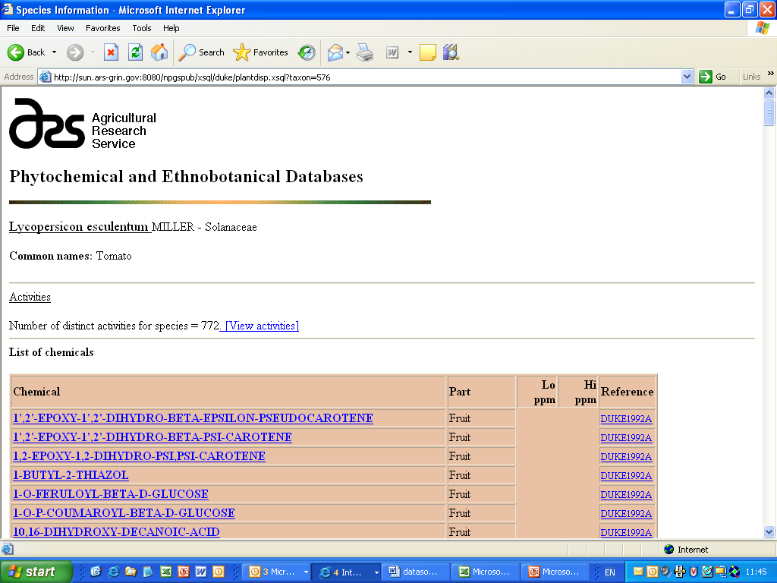
http://www.ars-grin.gov/duke/
Notes:
http://www.ars-grin.gov/duke/

Slide 37
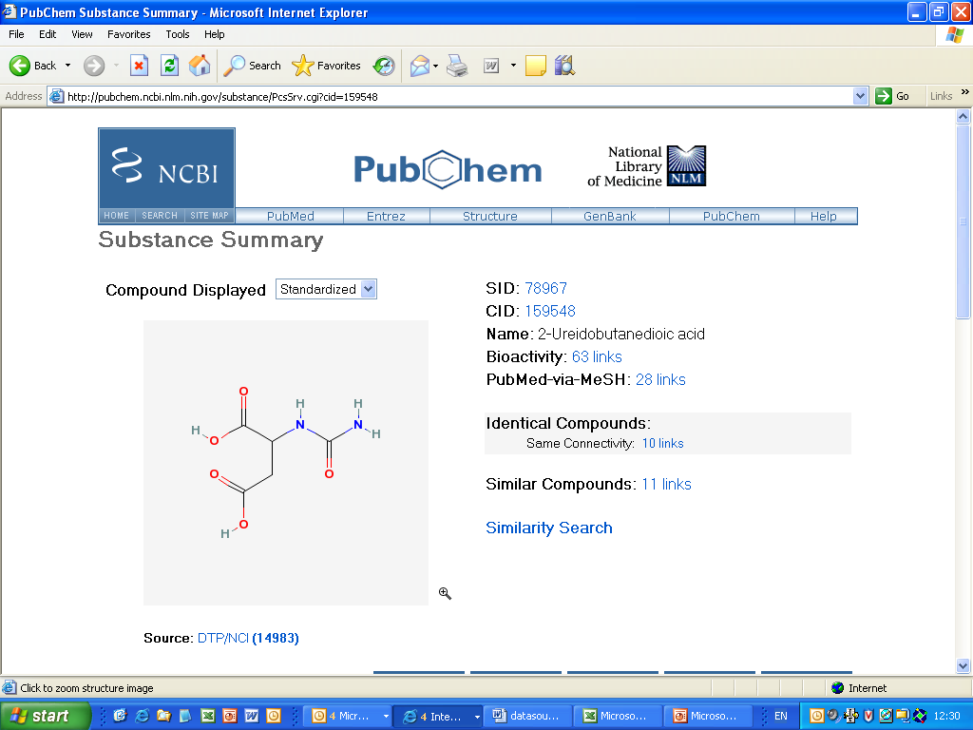
http://pubchem.ncbi.nlm.nih.gov/
Notes:
http://pubchem.ncbi.nlm.nih.gov/

Slide 38
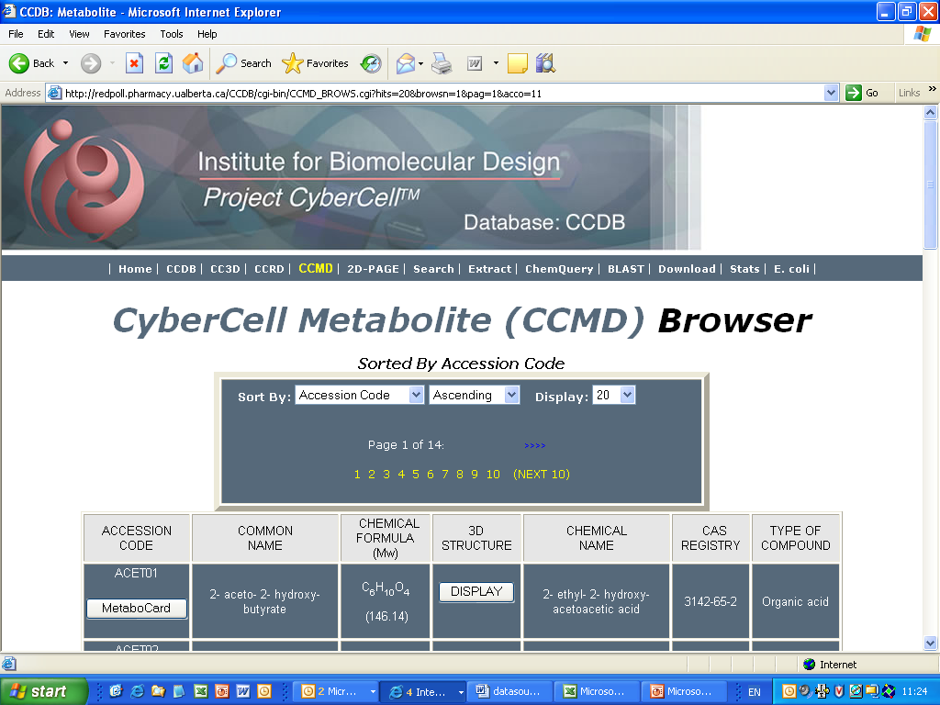
http://redpoll.pharmacy.ualberta.ca/CCDB/
Notes:
http://redpoll.pharmacy.ualberta.ca/CCDB/

Slide 39
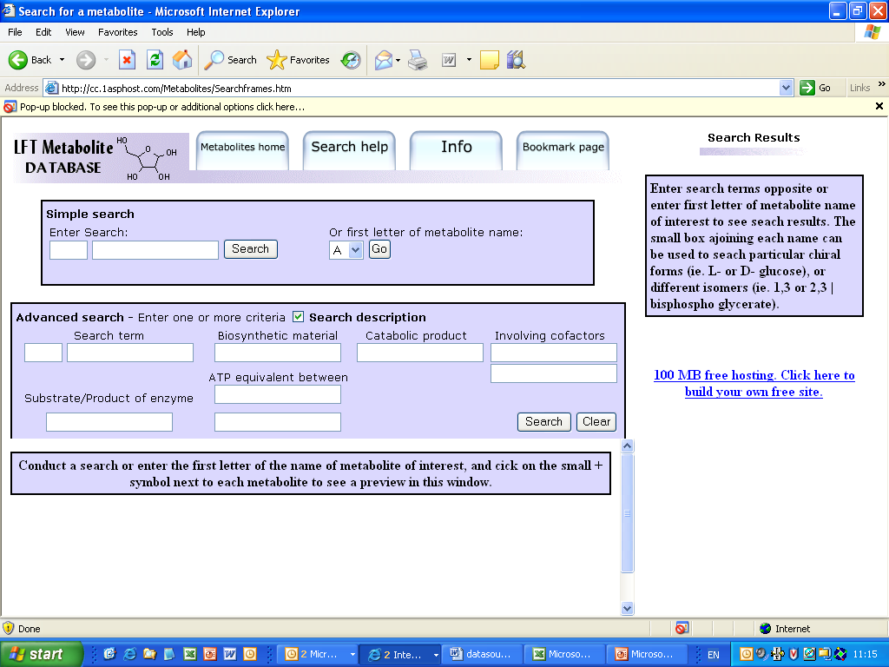
http://cc.1asphost.com/Metabolites/
Notes:
http://cc.1asphost.com/Metabolites/

Slide 40
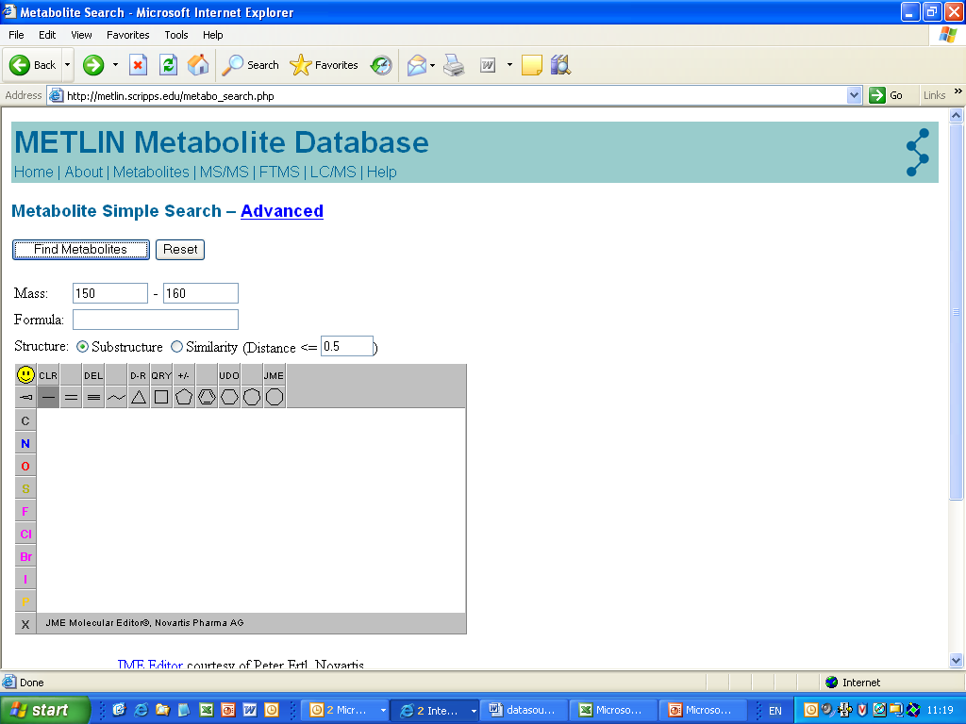
http://metlin.scripps.edu/
Notes:
http://metlin.scripps.edu/

Slide 41
Bronnen
Afbeeldingen van internet geraadpleegd op 5-10-2015
Wetenschappelijke literatuur:
Bolignon et al. 2014, Research Journal of Phytochemistry, 8: 16-20
Copyright @ I. Paffen, HAN

